Slide 1
Tests of neutrality week 41 r exercises

Slide 2
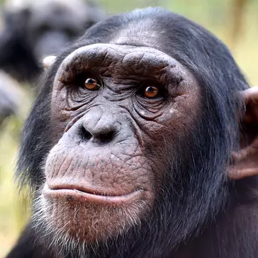
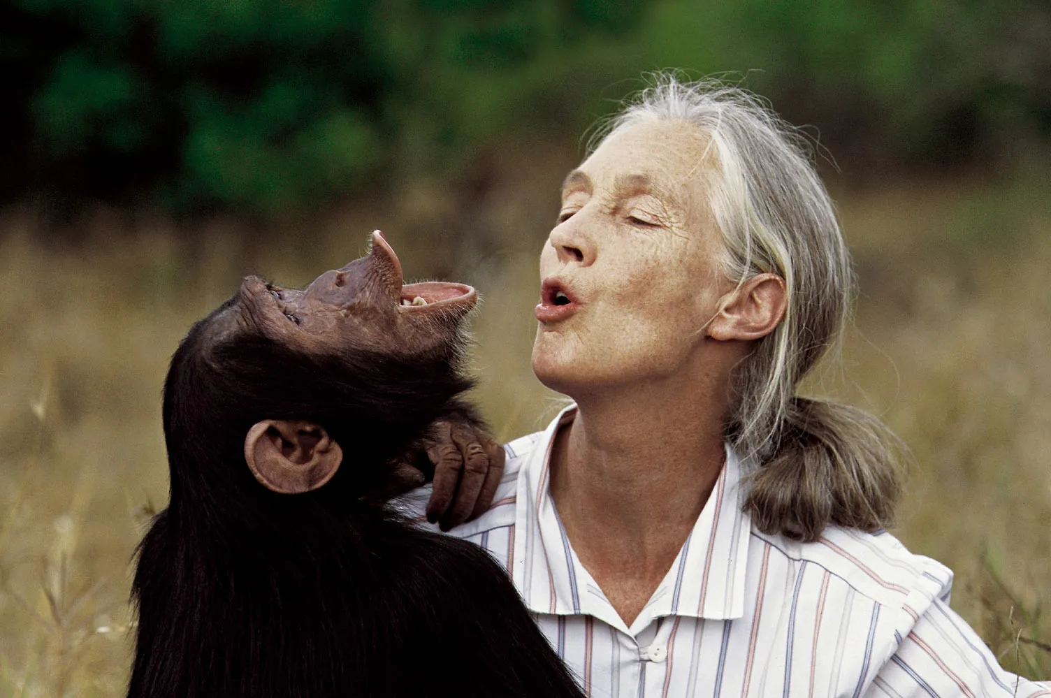
Primate of the Week
Chimpanzee
Pan Troglodytes
Africa
Closest human ancestar
In honor of Jane Goodall
Chimpanzees use tools

Slide 3
Plan for today
1. Recap of questions from Wednesday
Which formulas to know/what to know from the book chapeters
2. R exercises on SARS-CoV evolution

Slide 4
Viability rates
Viability rates
Viability selection: selection that occurs because individuals with different genotypes differ in their rate of survival from zygote stage to adulthood
How many individuals survive from one stage to another
-> whether certain genotypes (gene combinations) survive better than others.
Example: If 80% of AA individuals survive, but only 50% of aa do, the AA genotype has a higher viability rate → natural selection may favour it.

Slide 5
Tests of neutrality – counting mutations and dividing into categories
McDonald-Kreitman test
Idea: Compares synonymous vs. nonsynonymous mutations.
Neutral expectation: The ratio of nonsynonymous/synonymous changes should be the same within species (polymorphism) and between species (fixed differences).
If not:
Too many fixed nonsynonymous → positive selection (adaptive evolution)
Too few → purifying selection (removal of harmful mutations)
HKA test
Idea: compares variation within a species (polymorphism) to differences between species (divergence) at different genes)
Neutral expectation: Genes with more divergence should also have more polymorphisms
If not: suggest selection → some genes may evolve faster or slower than expected

Slide 6
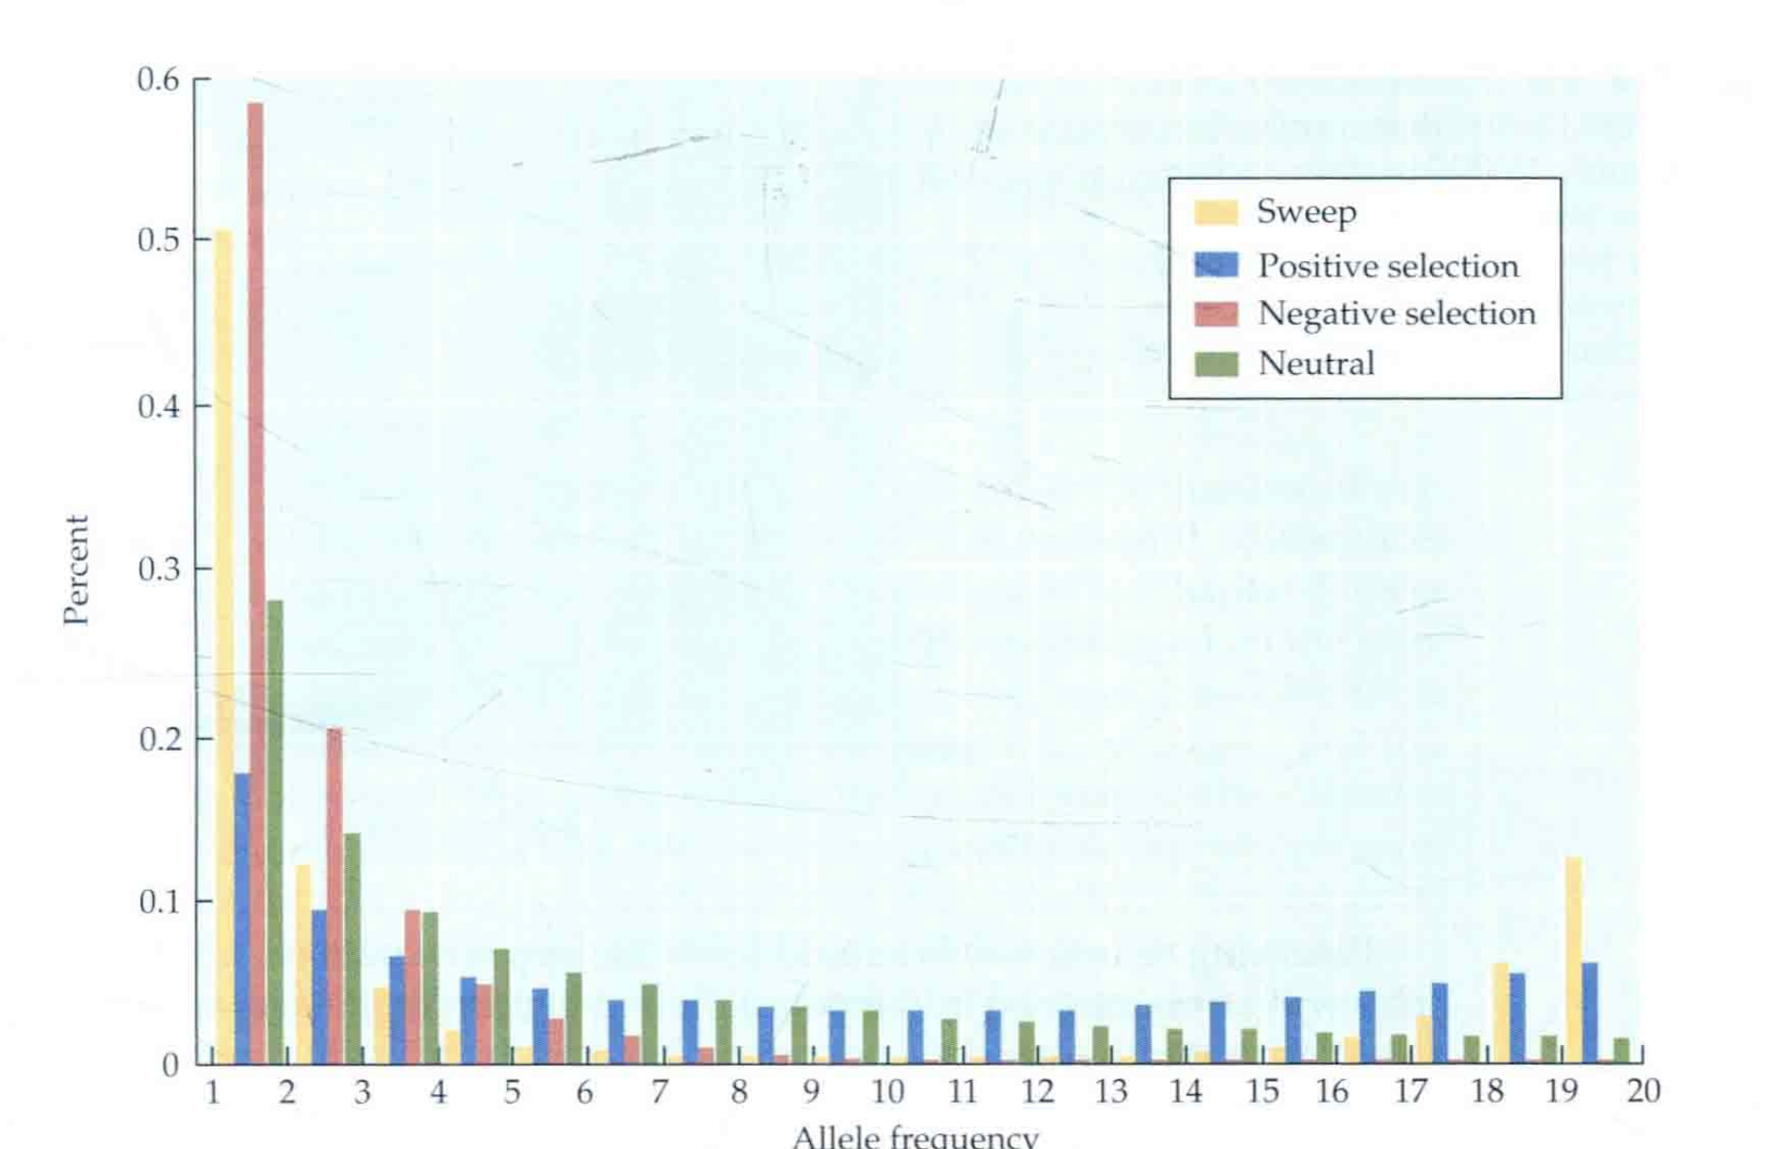
Tests of neutrality -counting mutations and dividing into categories
Site Frequency Spectrum (SFS)
Idea: Looks at how common or rare mutations are in a population.
Neutral expectation: Most mutations are rare, but there’s a predictable distribution.
Deviations tell us:
Sweep: excess of high AND low frequency alleles but fewer alleles of intermediate frequency: linked alleles go up in frequency, unlinked alleles go down
Balancing: linked alleles are maintained at higher frequencies than expected: SFS will contain more alleles in intermediate freq.

Slide 7
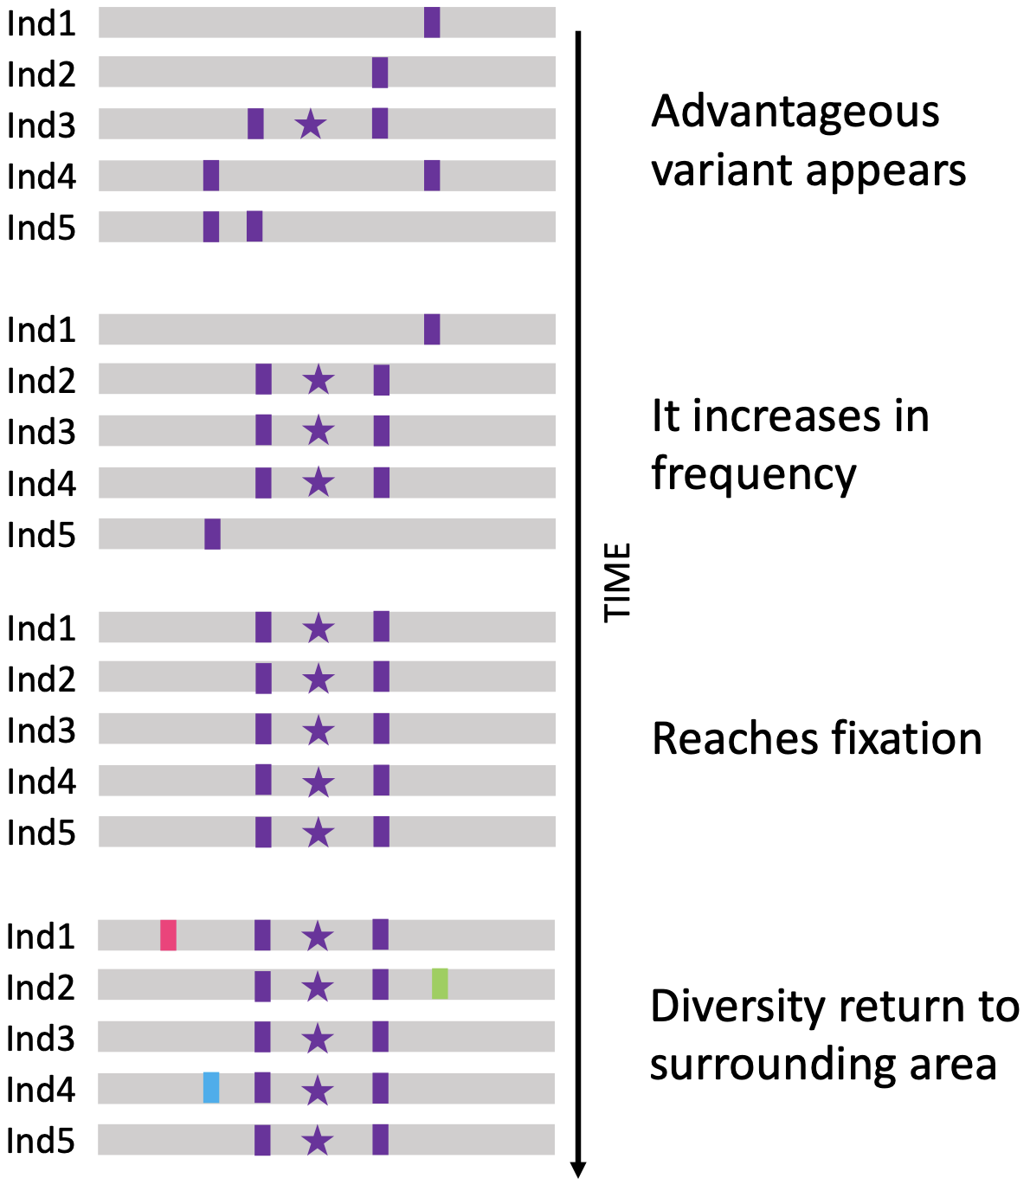
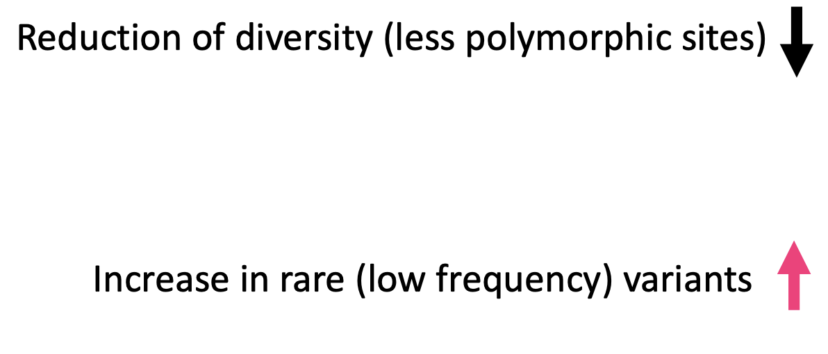
Tests of neutrality –allele frequencies approach
Tajima’s D Test
Idea: detect deviation in the distribution of allele frequencies from that expected under a neutral model
Compares two measures of genetic diversity:
Population diversity (number of polymorphisms)
Average pairwise differences (how different sequences are) (pi)
Interpretation:
D ≈ 0 → neutral evolution.
D < 0 → Recent selective sweep (excess of rare alleles)
D > 0 → Balancing selection (lack of rare alleles)
|D|>1.8 can reject neutrality with 5% significance (in the absence of recombination)
Notes:
Why D < 0 = excess of rare alleles → recent selective sweep or population expansion
When a beneficial mutation arises and rapidly spreads through the population (selective sweep):
It replaces most of the old genetic variation around that locus.
After the sweep, new mutations start accumulating — and they’re all rare, since they just appeared.
Therefore:
You get many segregating sites (increasing θ)
But average pairwise differences remain low (π is small, because everyone’s sequences are similar) → θ > π → D < 0
You can get the same pattern after a recent population expansion, since a growing population also generates lots of new rare mutations.
🔸 Why D > 0 = lack of rare alleles → balancing selection or population contraction
If balancing selection maintains multiple alleles in the population (e.g., heterozygote advantage):
Several alleles remain at intermediate frequencies.
So, there are fewer rare alleles, and many individuals are quite different from each other.
This means:
π increases (more differences between sequences)
θ decreases (fewer segregating sites, since rare mutations are missing) → π > θ → D > 0
Similarly, a population bottleneck can remove rare alleles, leading to a similar excess of intermediate-frequency variants and D > 0.

Slide 8
Today
R exercises

Slide 9
Next week
autumn break !

